Slide 1
CYBER HAVEN Game Programming
By Kyra B.D, James F, Maro S.S and Nguyen N. M.T

Slide 2
Overview
One day Cyrus was out adventuring, when suddenly a tornado appears and drops him off at an unknown city; Cyber Haven. This city full on destruction but Cyrus to escape and find his way safely to the space station where he can go to : MARS
However maybe obstacles get in his way, Evil robots are trying to stop him!! He must overcome them! Help Cyrus find his way safety.
Escape the high skyscrapers
Defeat enemy bosses
Get to the station to fly to mars
Main objective

Slide 3
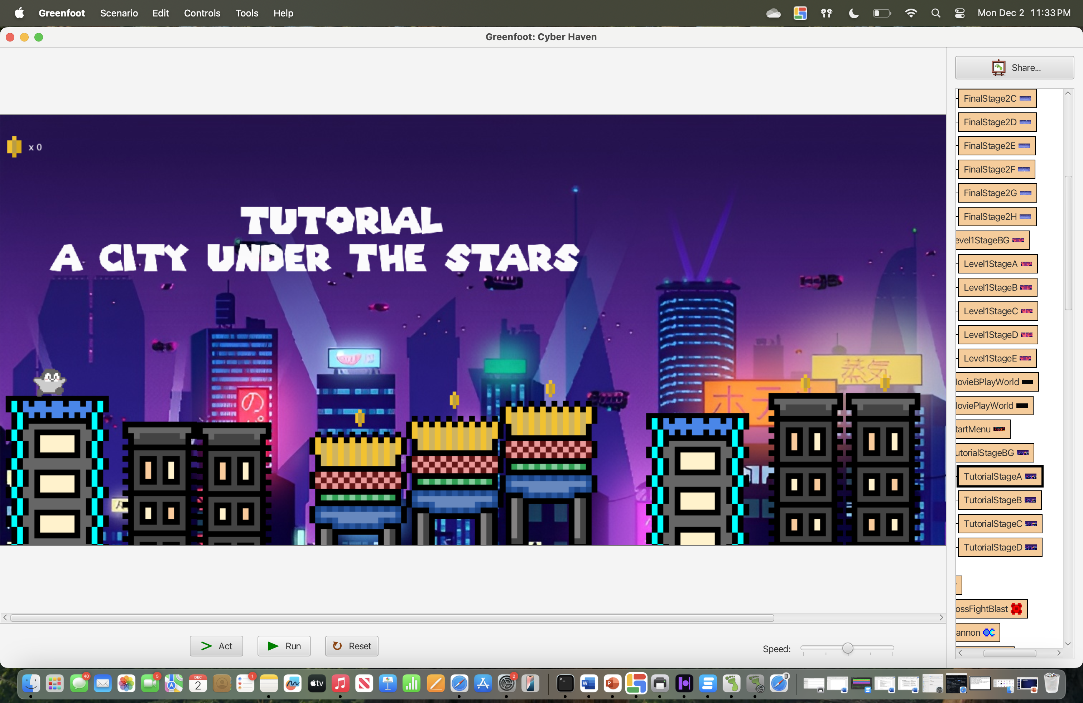
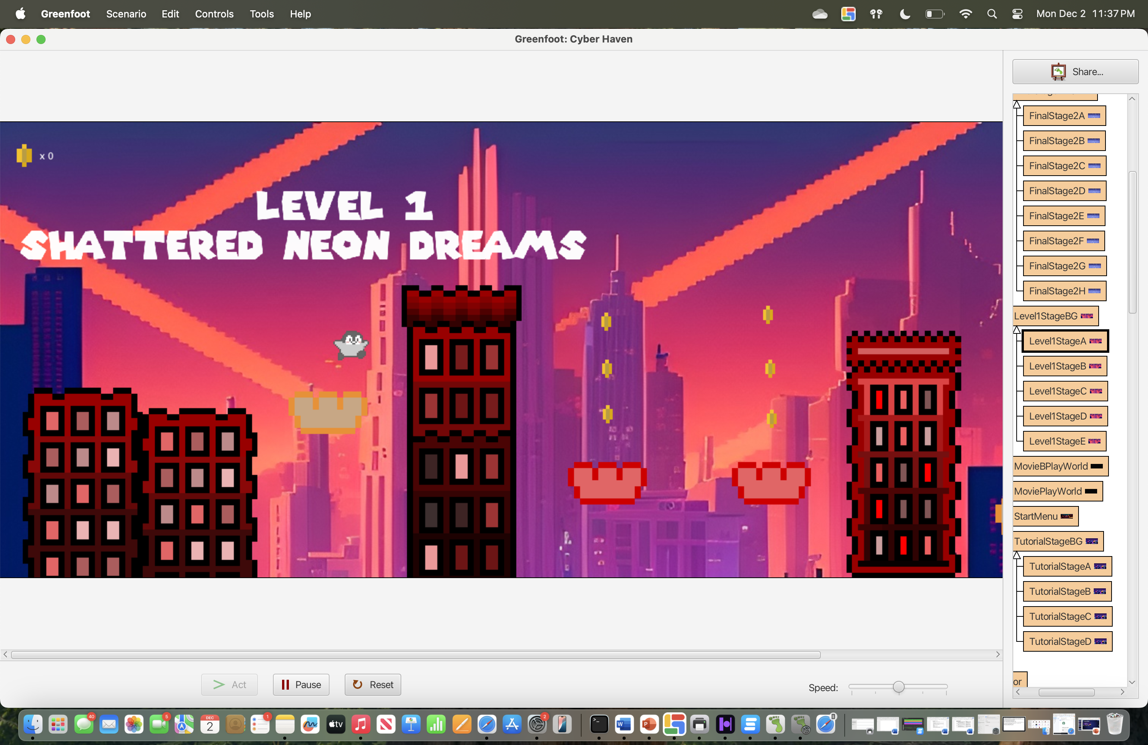
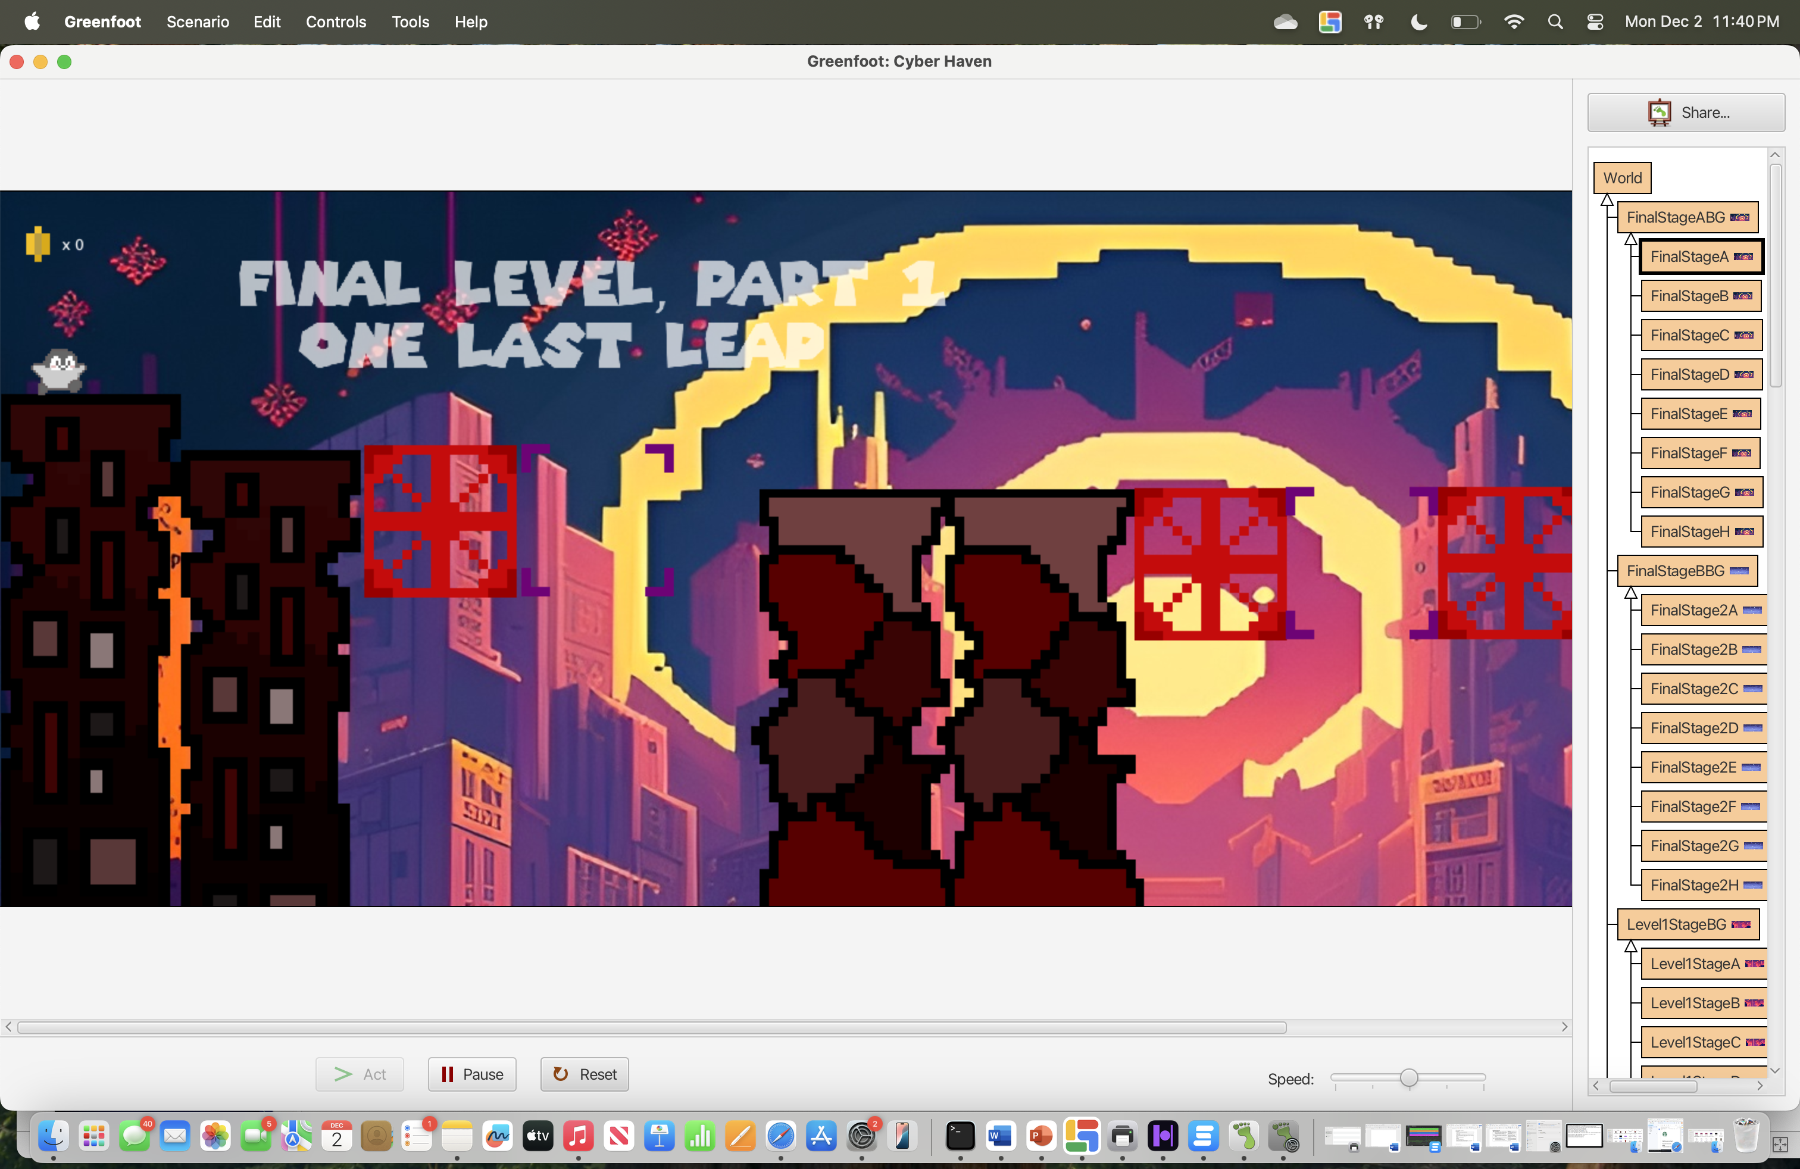
Overview

Slide 4




Music
For our game, we used a selection of tracks created by ri0genmusic on YouTube.
All of the links to the songs, as well as his channel, can be found in our Game Design Document.

Slide 5




Difficulties
Platforms
Cyrus stopped jumping on the red bounce platform
Moving platforms didn’t work
Moving platforms didn’t allow Cyrus to stand on it
Transitions
When Cyrus reached the end of the map it wouldn’t transition to the next level
Our gif animated scene kept repeating
Boss Level
Hard time coding the shooting from the boss
Boss would glitch and not move naturally

Slide 6


Slide 7

CONTRIBUTIONS
KYRA
MARO
Worked on the bounce and moving platforms
Worked on Cyrus and the menu
VIVIAN
JAMES
Worked on Cyrus and the background music
Worked on the art, game design and bosses

